Slide 1

Data Programming- BDAT1004 Final Group Project
By: Group 1 Professor: Ethan Davis

Slide 2
Project Summary:
Extracted data of 50 Cryptocurrencies using api link from coinbase.com
Here is the link: https://api.coinbase.com/v2/prices
Stored data in MongoDB Atlas from above link.
After storing into database, we fetched data and displayed on our website.
It updates every 24 hours and fetches new price of those currencies.
We can even search particular currencies.
Created line chart for BTC Cryptocurrency and bar chart for Top five Cryptocurrencies.

Slide 3
Project Team:
Satish Kumar (200574904) | Dhyan Trivedi (200565531) | Kush Parmar (200528755)
Role: Developer, Business Analyst, Data Analyst | Role: Developer, Business Analyst, Data Analyst | Role: Data Analyst, Project Manager, Business Analyst

Slide 4
Tools and Technologies used:
Python
JavaScript
HTML
CSS
MongoDB Atlas
Google Charts
Web application framework - Flask

Slide 5
Steps involved in our project:
Step 1: Extract the data from the api link.
Step 2: Stored it in MongoDB Atlas.
Step 3: Displayed data from Database to our website.
Step 4: Fetch new data at every 24 hours.
Step 5: Added the search button, so we can search data of particular Cryptocurrencies.
Step 6: Visualize the data using line chart and bar chart.

Slide 6
Why Mongo DB Atlas:
We have used Mongo DB Atlas
MongoDB is a popular, open-source NoSQL database program
it stores data in a flexible, JSON-like format.
MongoDB is designed to be highly scalable, flexible, and easy to work with for both developers and administrators.
MongoDB is a versatile and powerful database solution suitable for a wide range of applications, from small-scale projects to large enterprise systems.

Slide 7
Project Output images:

Slide 8
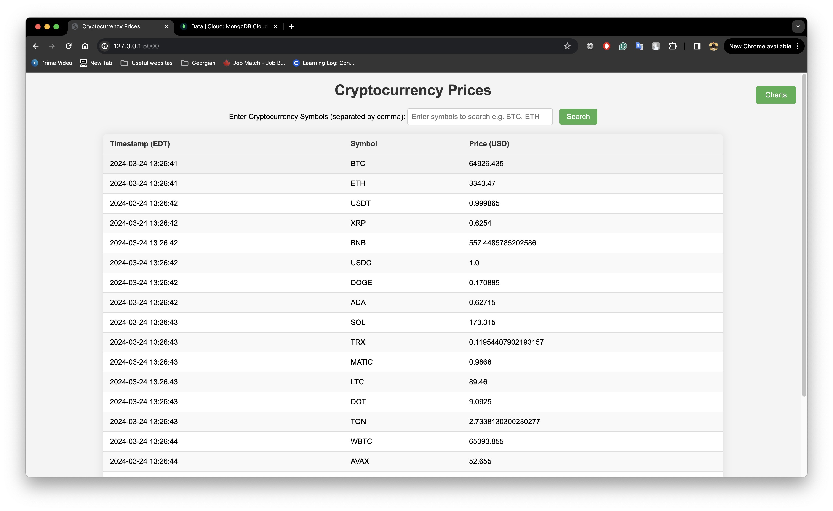
Home Page:

Slide 9
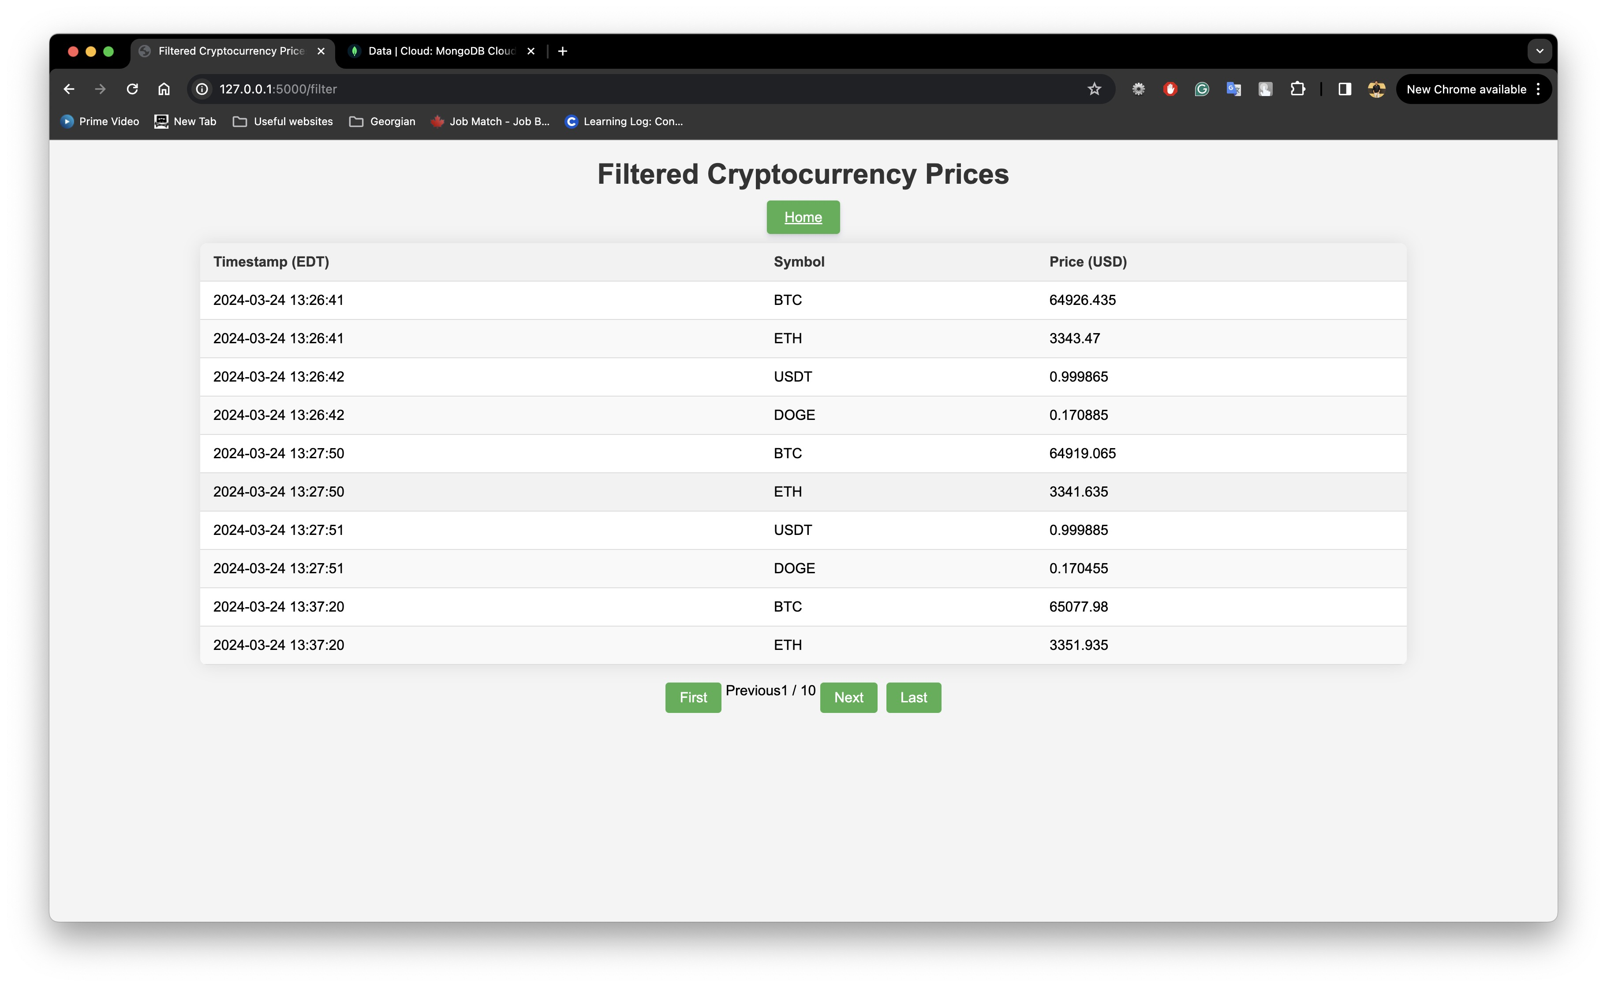
Filter page:

Slide 10
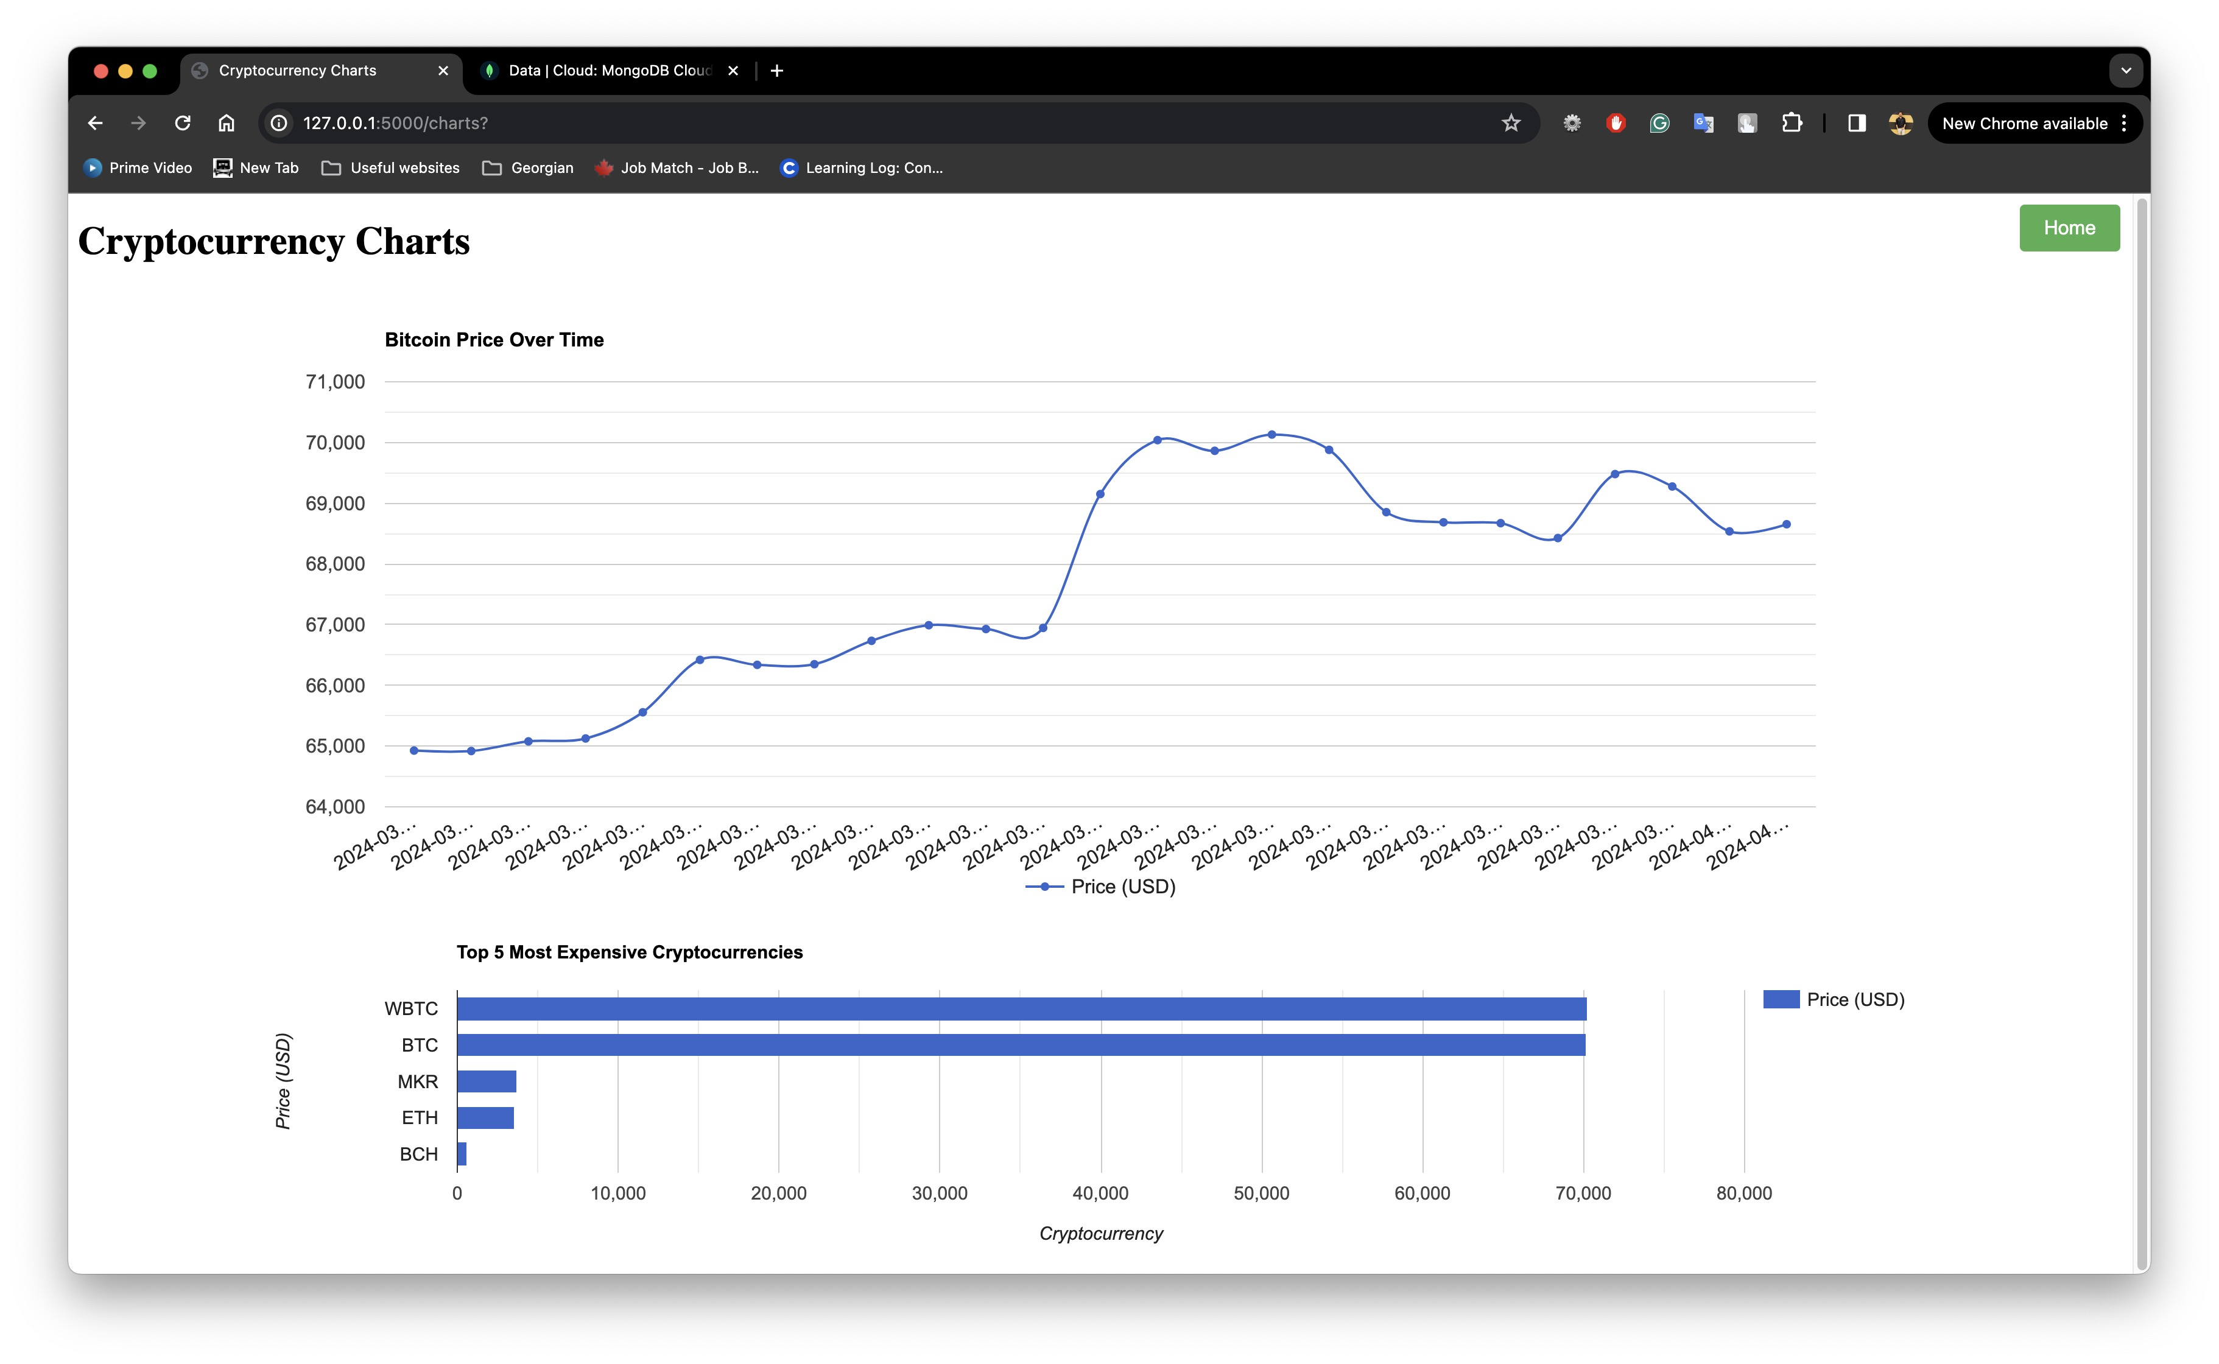
Charts page:

Slide 11
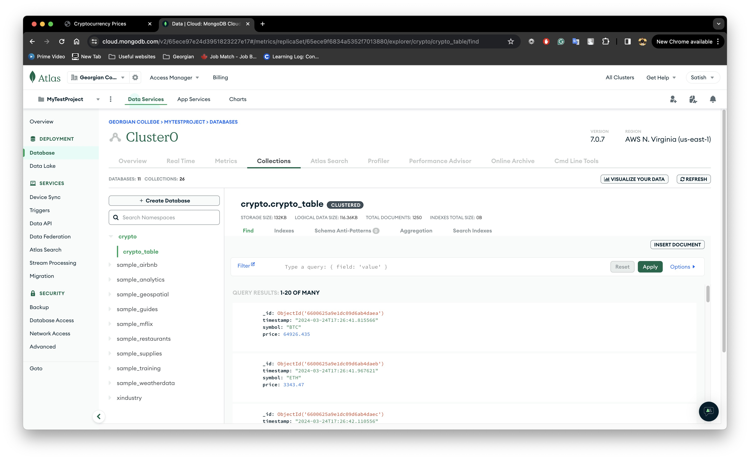
Database:

Slide 12
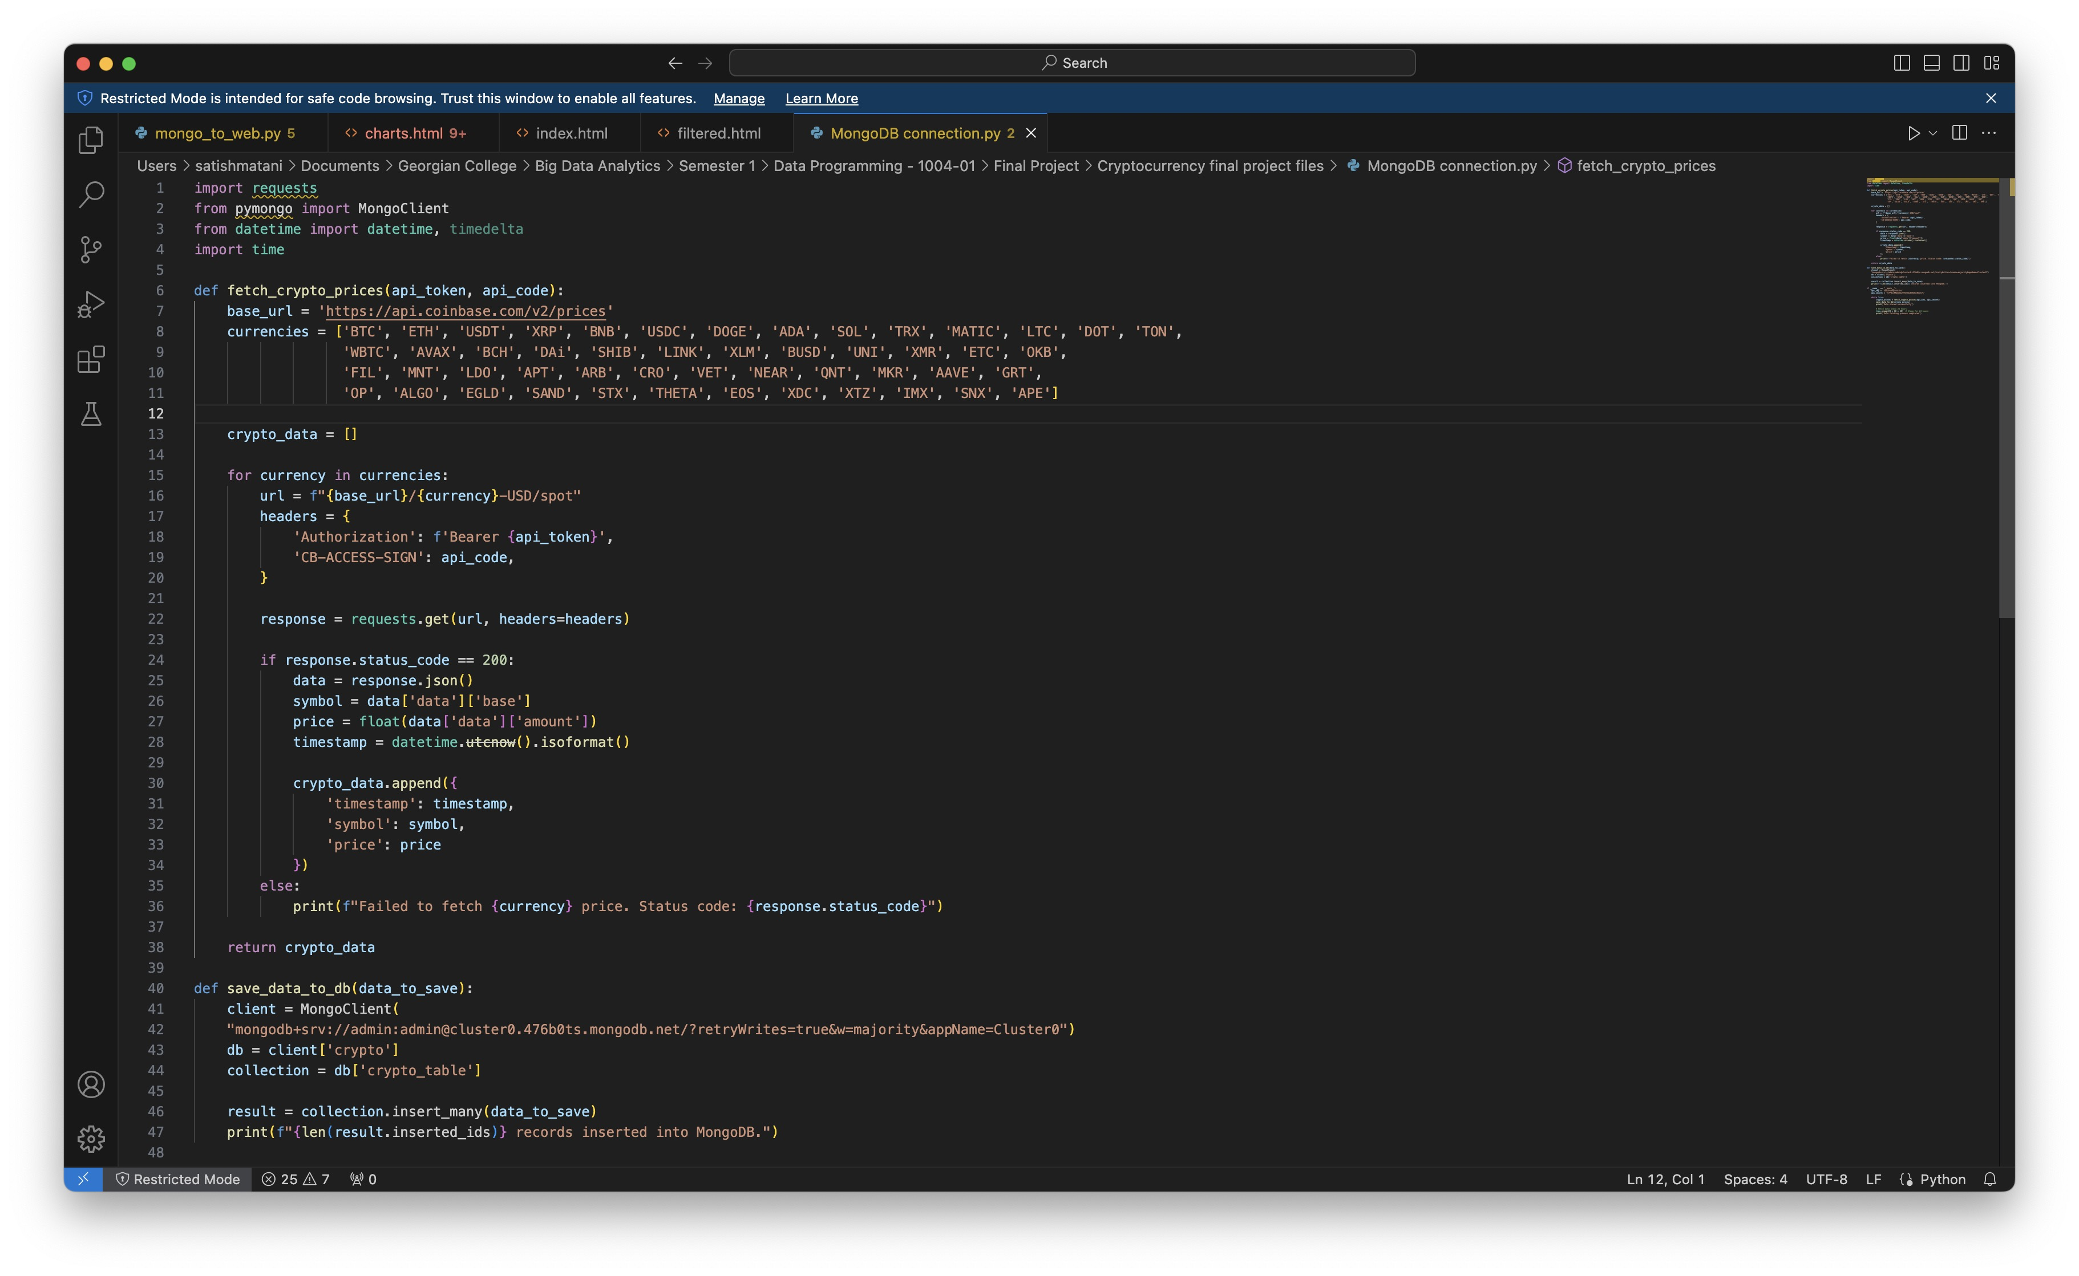
API to Database code:

Slide 13
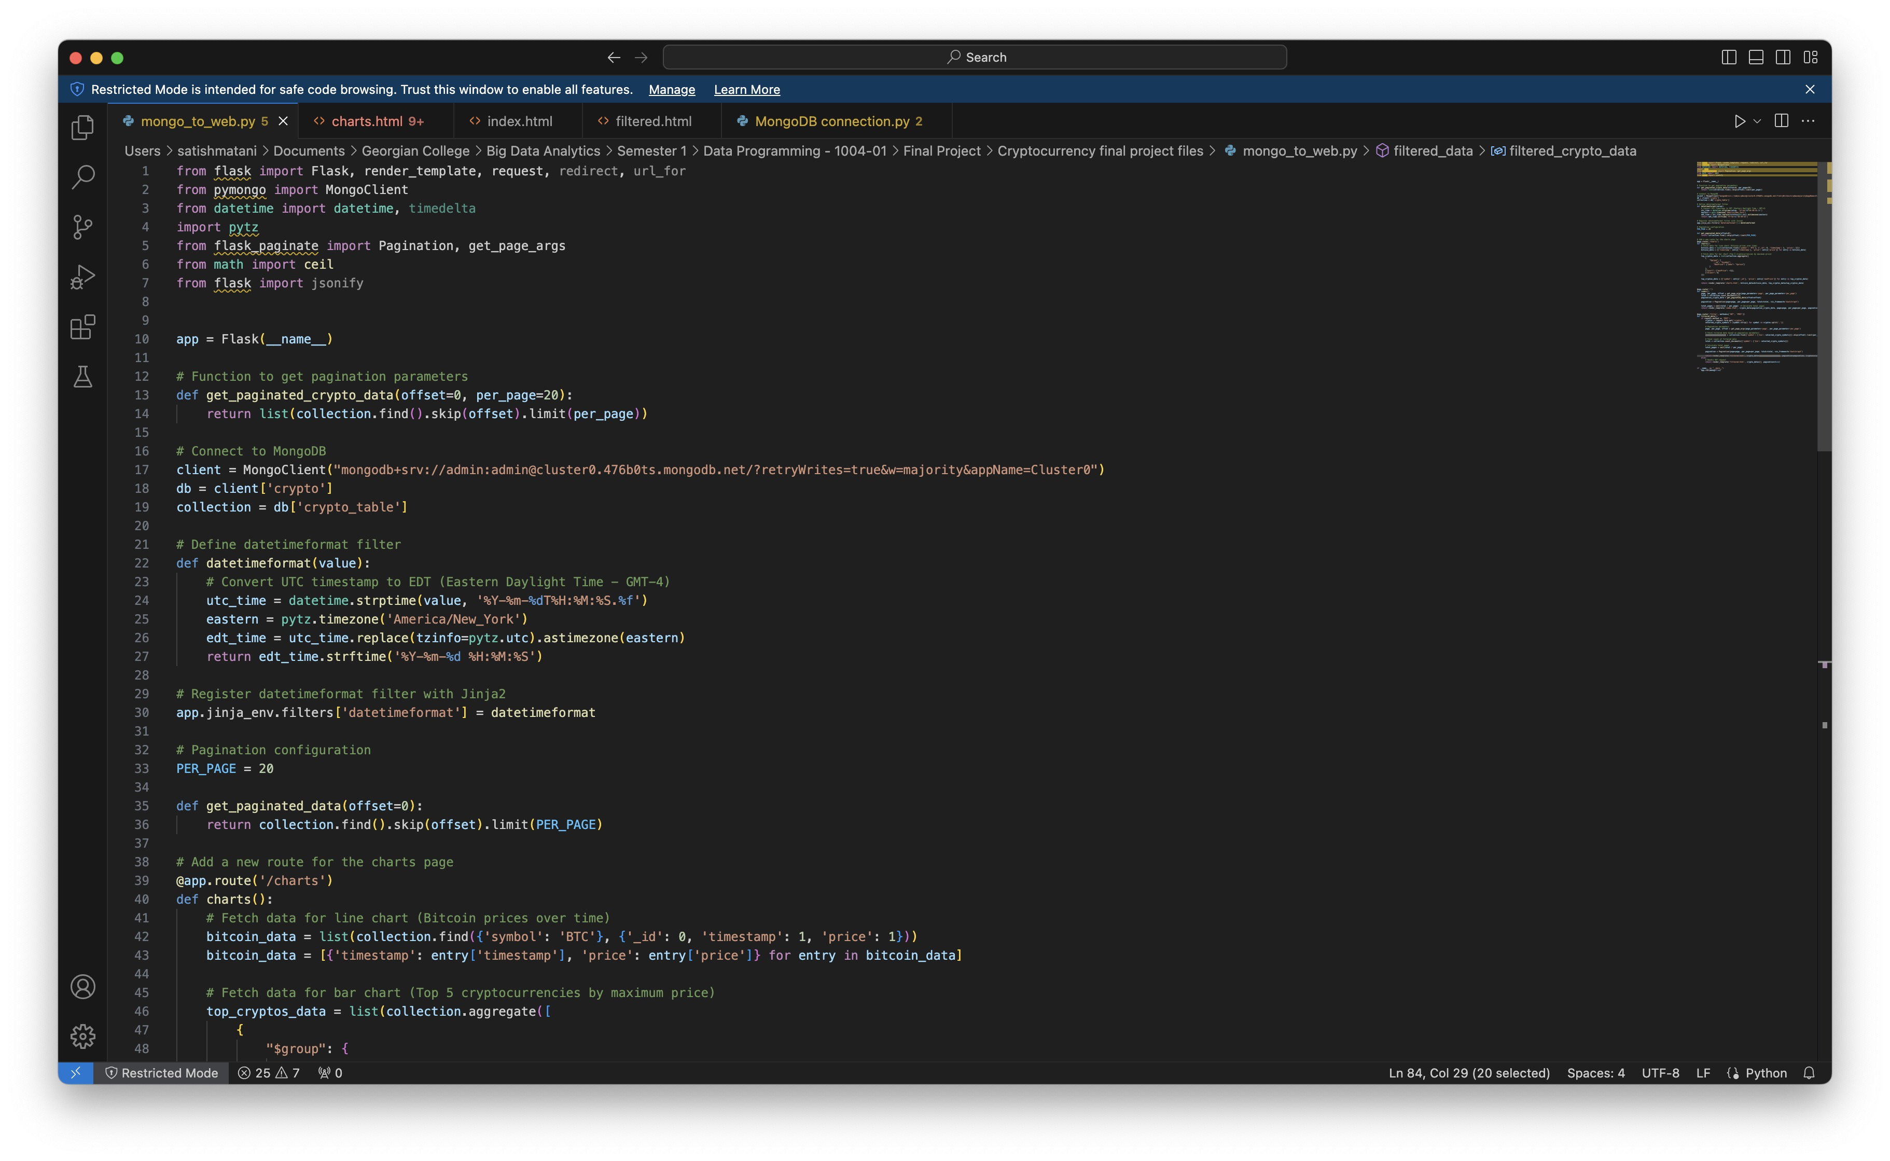
Database to web code:

Slide 14
Live Demonstration

Slide 15
Fit Gap Analysis
Desired Requirements | Current state | Gap | Corrective steps Required
Usage of Python | Every code is written in Python | There are no gaps between desired requirements and current state | No additional steps are required as all the desired requirements are met
Acquisition of a data source from URL | Successful acquisition of data source from an URL
Store acquired data in a cloud database | Successful data storage in Mongodb Atlas cloud database
Run a pseudo-batch process | Successfully ran pseudo-batch process which runs every 24 hours
Display results using Flask/Django framework | Successfully displayed stored data in website using Flask framework
Demonstrating visualizations using Google charts | Successfully used google charts to display visualizations in forms of graphs

Slide 16
Thank You

